Slide 1
CALCIUM DEFICIENCY
By
Dr. Hussein AlNaji

Slide 2
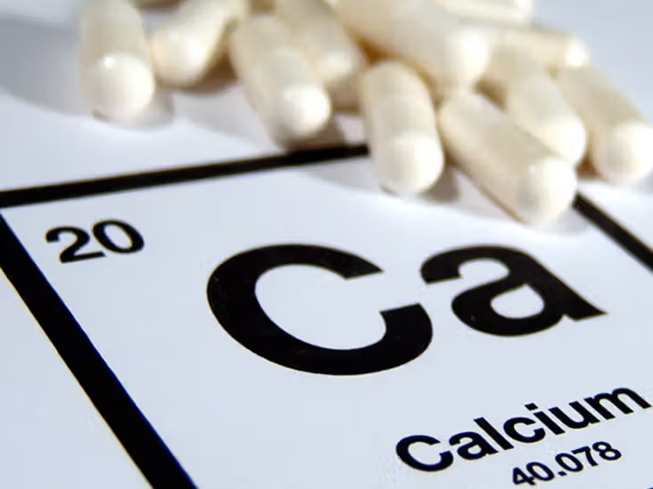
CALCIUM DEFICIENCY
Calcium deficiency can be primary or secondary, but in both cases, the end result is a type of osteodystrophy, with the specific disease depending largely on the species and age of the animals affected.

Slide 3
ETIOLOGY
A primary deficiency attributable to a lack of calcium in the diet is uncommon.
a secondary deficiency attributable to a marginal calcium intake aggravated by a high phosphorus intake is not uncommon.
In ponies occur du to
a diet depresses intestinal absorption and retention of calcium in the body.
The resorption of calcium from bones is increased as a result of hyperparathyroidism (secondary nutritional hyperparathyroidism).
Hypoparathyroidism, either primary or secondary to renal disease,
Reduces intestinal and renal reabsorption of calcium and causes seizures and muscle fasciculation.

Slide 4
PATHOGENESIS
The main physiologic functions of calcium
The formation of bone and milk, in bone the Ca formation hydroxyapatite (Ca₁₀ (Po4)₆ (OH)₂ .
Participation in the clotting of blood.
3. The maintenance of neuromuscular excitability
4- Cardiac (contraction & depolarization in heart).
5- Intracellular messenger

Slide 5
Calcium and phosphate homeostasis.
A decrease in extracellular Ca2+ concentrations or an increase in phosphate (PO4) concentrations leads to a parathyroid hormone (PTH) release from the parathyroid gland, which in turn increases renal reabsorption of Ca2+ , renal activation of vitamin D, urinary PO4 excretion, and bone resorption. In turn, vitamin D increases intestinal absorption and renal reabsorption of Ca2+ and PO4. An increase in Ca2+ concentration stimulates the thyroid gland to secrete calcitonin to inhibit osteoclastic bone resorption.

Slide 6
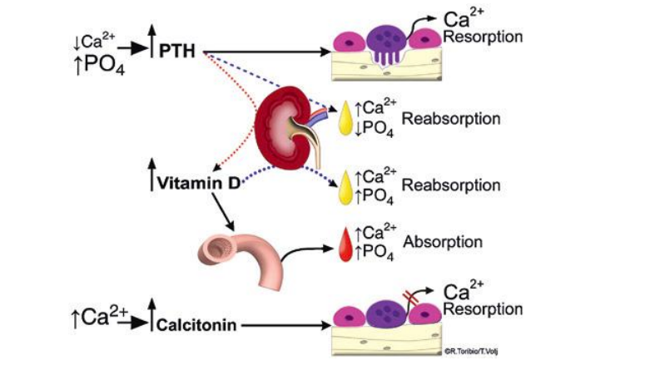

Slide 7
CLINICAL FINDINGS
1- Characterized by deformity of the gums, poor development of the incisors, failure of permanent teeth to erupt for periods of up to 27 months.
2- A calcium deficiency can occur in lactating ewes and sucking lambs, whose metabolic requirements for calcium are higher than in dry and pregnant sheep.
3- Tetany and hyperirritability do not usually accompany hypocalcemia in these circumstances, probably because it develops slowly.
4- Attention is drawn to the presence of the disease by the occurrence of tetany, convulsions, and paresis, but the important signs are ill-thrift and failure to respond to anthelmintics.
5- In affected sheep, the bones can be felt to fluctuate.

Slide 8
SPECIFIC SYNDROMES
a- Primary Calcium Deficiency
No specific syndromes are recorded, although the complex relationship between overall nutrition, including concentration or amount of calcium in the diet, and bone development should be noted.
b- Secondary Calcium Deficiency
Rickets, osteomalacia, osteoporosis, osteodystrophia fibrosa of the horse, goat, and pig and degenerative arthropathy of cattle are the common syndromes in which secondary calcium deficiency is one of the specific causative factors.

Slide 9
Clinical pathology
Serum calcium and phosphorus.
Radiography.
Necropsy findings
Osteoporosis; low ash content of bone.
Diagnostic confirmation
Histology of bone and bone ash analyses.
Differential diagnosis. :
Treatment
Calcium salts parenterally (for tetany) and orally (for prolonged correction of deficiency)

Slide 10
Thank You

